Slide 1
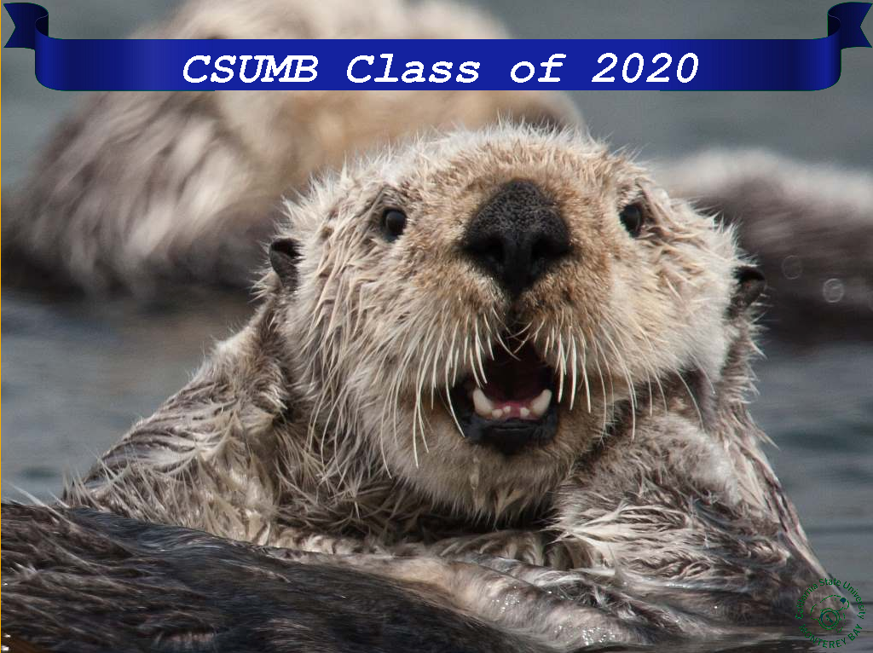
CSUMB Filter
Whether it is a graduation or just trying to recognize you team at California State University Monterey Bay the CSUMB filter will work for you. The filter provides you with a banner at the top of your photo with customizable text to relate to any function that is taking place.
To use the filter select a picture you would like to modify. Assign the picture to a variable with the command “pic = pickAFile()”. Then run the filter wit h the command “csumb(pic)”. Once the command has been entered you will be prompted to type in the text for that banner you would like to display. Every picture is customizable and includes the CSUMB logo at the bottom right of each image.

